Slide 1
Microsoft Power Automate Empowerment
Notes:
Hi, Welcome to Microsoft Power Platform + Dynamics 365 Bootcamp.

Slide 2
Course Overview
Day 1
Empowering everyone with Power Platform
Day 2
Power Automate Introduction
Day 3
Power Automate Project Scenarios
Day 4
Monitoring & Administration of Power Automate
Introduction to Power Platform
Microsoft Power Platform momentum
Why Power Platform?
Customer Stories
Power Platform Components Demo
Power Platform Account Setup
Microsoft Flow Basics
Microsoft Flow Templates
Decision Making with Flow
Conditions, Switches, Scope & Context of Decision-Making Control Elements
Building Workflows with Power Automate
Hands on Lab - Microsoft Flow
Approve / Reject Workflow Scenario
Recurrence Workflow Scenario
Errorless workflows Scenario
Build and Implement Custom Connector
Azure Cognitive Services AI Integration Workflow Scenario
Power App Integration Workflow Scenario
SQL Server Integration Workflow Scenario
HoL - End to End Business Flow with all Scenarios
UI Flows
Import, Export Flows
Distribute Flows
Sharing of Flows across workspaces
Different Flow Environments and Code Promotion
Data Policies & Integration Check Points
Flow History and Analytics
HoL - Check your Knowledge

Slide 3
Day3: Power Automate Project Scenarios

Slide 4

Agenda
Approve / Reject Workflow Scenario
Recurrence Workflow Scenario
Errorless workflows
Build and Implement Custom Connector
Azure Cognitive Services AI Integration Workflow Scenario
Power App Integration Workflow Scenario
SQL Server Integration Workflow Scenario
HoL - End to End Business Flow with all Scenarios

Slide 5
Approval Workflow

Slide 6
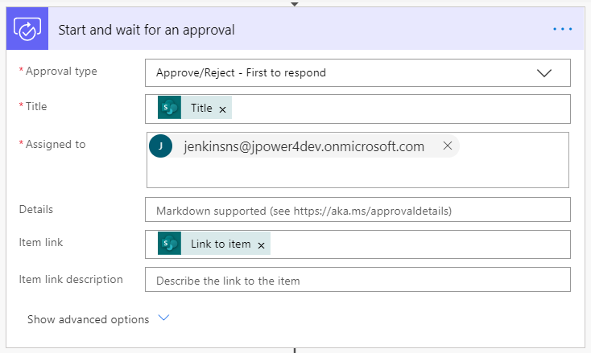
Approve / Reject Workflow
With Power Automate, you can manage the approval of documents or processes across several services, including SharePoint, Dynamics 365, Salesforce, OneDrive for Business, Zendesk, or WordPress.
To create an approval workflow, add the Approvals - Start an approval action to any flow. After you add this action, your flow can manage the approval of documents or processes. For example, you can create document approval flows that approve invoices, work orders, or sales quotations. You can also create process approval flows that approve vacation requests, overtime work, or travel plans.
Notes:
https://support.microsoft.com/en-in/help/4513676/differences-between-flow-approval-actions

Slide 7
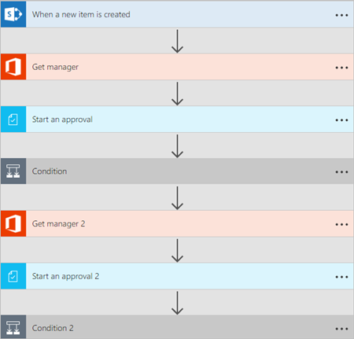
Sequential approval flows.
Some workflows require pre-approval before the final approver is required to sign off. For example, a company may have a sequential approval policy that requires pre-approval for invoices over $1000.00 before they're approved by the Finance department.

Slide 8
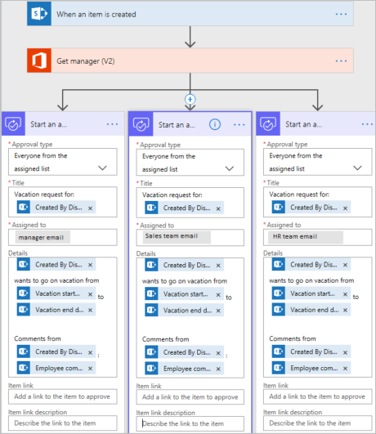
Parallel approval flows
In a parallel approval workflow, multiple persons are required to approve items such as invoices, purchase orders, vacation requests, etc. Each person's approval is independent of all other approvers.

Slide 9
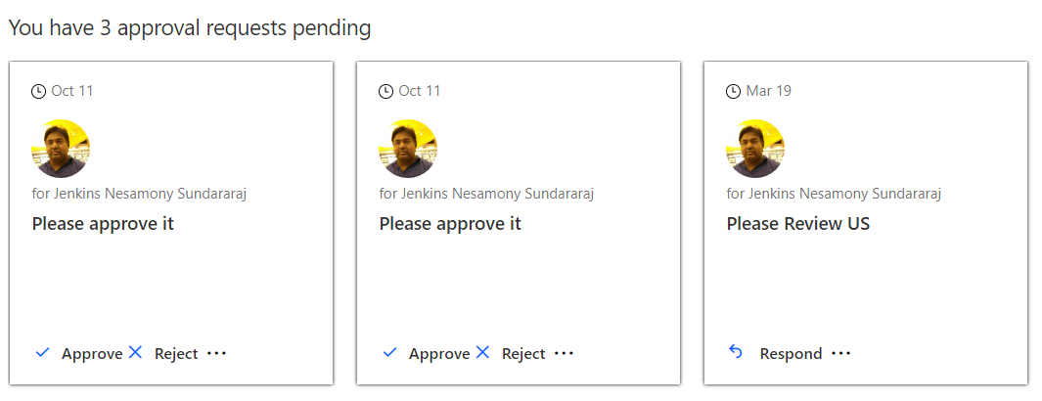
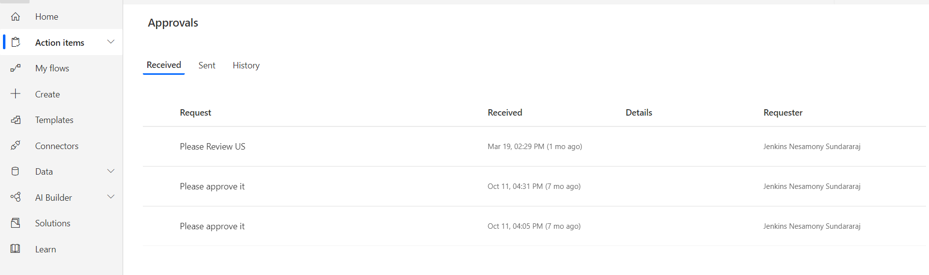
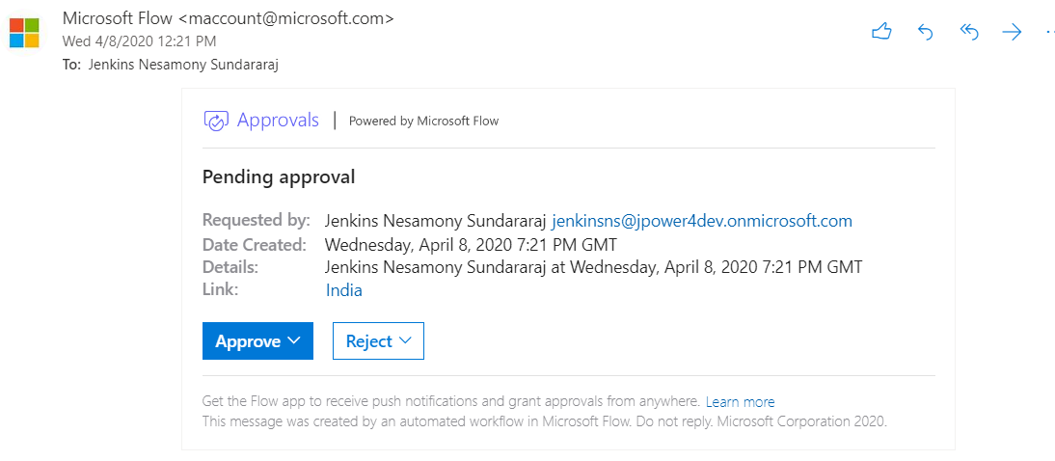
View and manage pending approval requests
Power Automate - Home Page
Power Automate – Action Items -> Approvals
Email

Slide 10
Recurrence Workflow

Slide 11
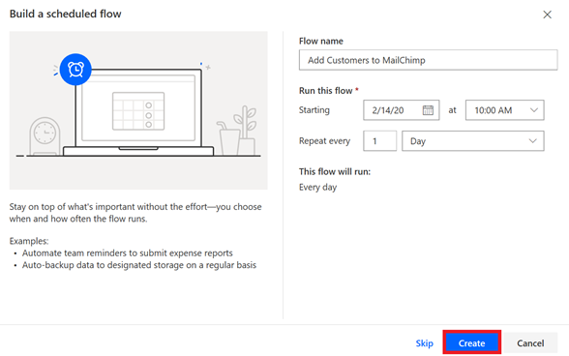
Recurrence flow
Create a flow that performs one or more tasks (such as sending a report in email):
once a day, an hour, or a minute
on a date that you specify
after a number of days, hours, or minutes that you specify

Slide 12
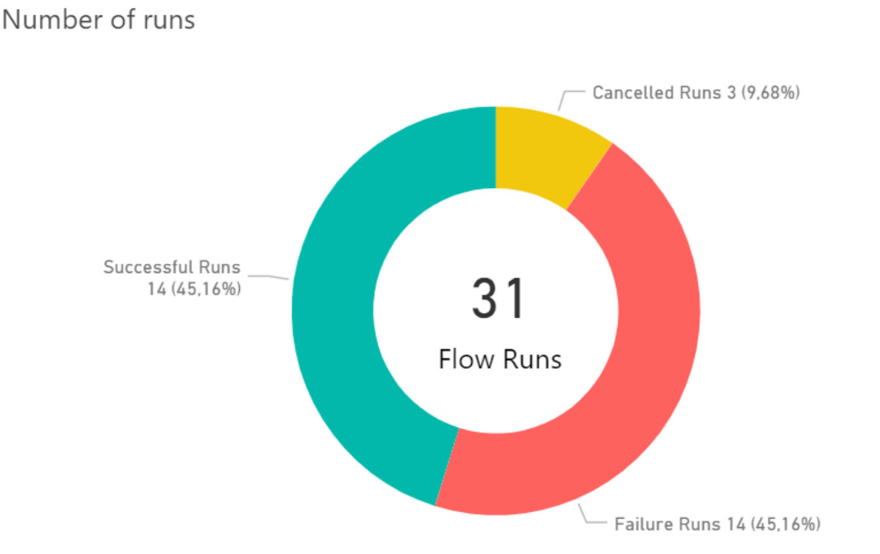
Errorless workflows

Slide 13
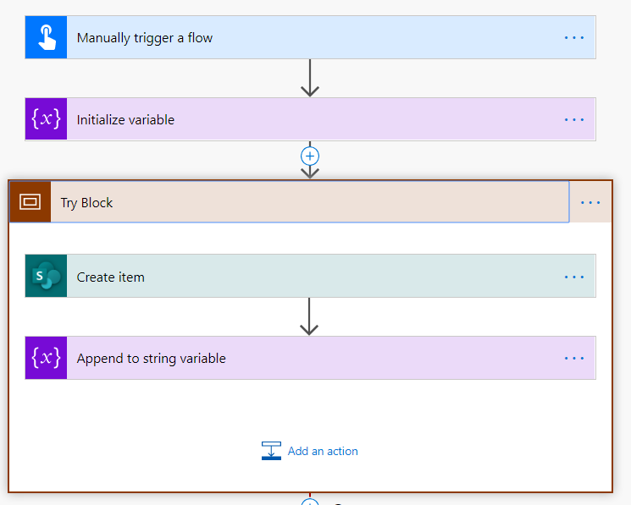
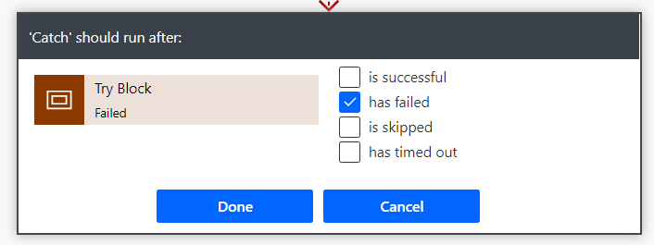
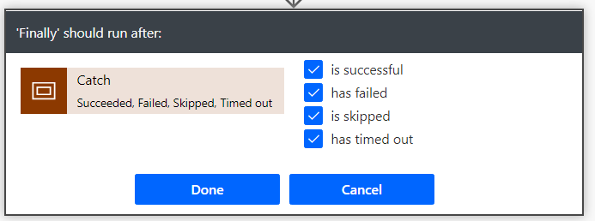
Try, Catch, Finally and Scope
Scopes are a simple way to group two or more actions together. When you put actions inside a scope, they can be visually collapsed so that you cake make the presentation inside of the designer much simpler.
Try – The “Try” scope should contain all the actions from the main flow of the process.
Catch – The “Catch” scope is configured to run after “Try” block is failed. This is implemented using “Configure run after “ feature .
Finally – The “Finally” block should run no matter what happens in the previous action.
Using “Scope” and “Configure run after” feature, we can implement try ,catch pattern in Power Automate easily.

Slide 14
Connectors

Slide 15























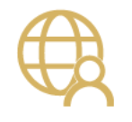




Integrate the systems you’re already using…

Slide 16
Why build a connector?
Enterprise developers
Looking for connectivity to a service we don’t currently support
Need connectivity to a custom or internal service
Partners and ISVs
Expand the number of services you integrate with
Provide the extensibility your customers need
Increase exposure and adoption

Slide 17
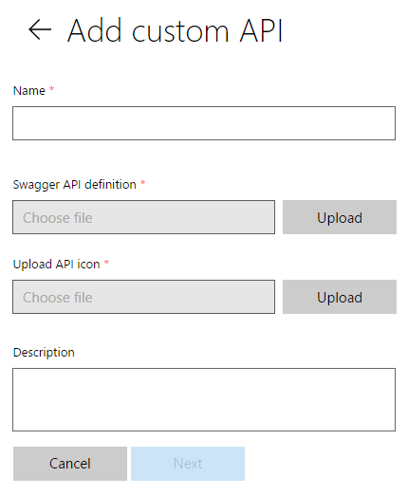
Connecting your services to PowerApps & Flow
PowerApps & Flow are fully metadata-driven and extensible so you can connect to any of your own services
Even connect to 3rd party services you consume
Custom APIs within an organization
Scoped to a company so that you can build something that’s unique to that organization
Leverage Azure functions within your apps & flows
Via custom APIs today, integrated support coming soon

Slide 18
Building a Custom Connector



Develop
Build, secure and describe your API
Import from existing artifacts (Open API, Postman) or build from scratch
Test
Validate your API calls
Use in Flow and PowerApps for E2E testing
Share
Allow other users within your organization to use your connector

Slide 19
Building a Custom Connector




Develop
Build, secure and describe your API
Import from existing artifacts (Open API, Postman) or build from scratch
Test
Validate your API calls
Use in Flow and PowerApps for E2E testing
Share
Allow other users within your organization to use your connector
Certify
Share your connector with all users of Flow and PowerApps
Only for Public Connectors

Slide 20
Custom connector architecture
Hosting environment
Connector ID
+
Operation
+
Connection ID
Host
+
Path
+
Credentials
RESTful API
Microsoft Flow
Custom connector
PowerApps

Slide 21
Using your own Web API
Hosting environment
Your
Web API
Microsoft Flow
Custom Connector
PowerApps

Slide 22
Securing your Web API
Hosting environment
AAD Application #1
AAD Application #2
Your
Web API
Microsoft Flow
Custom Connector
PowerApps

Slide 23
Connectors Demo

Slide 24












Custom Connector Resources
https://docs.microsoft.com/connectors
Custom connectors
From Postman Collection
Webhooks
Dynamic values/schema
https://aka.ms/apiconnectors
Submit for certification
Example Video : https://youtu.be/dBCS1nPsDiE
Notes:
https://www.googleapis.com/books/v1/volumes?q=search
https://www.googleapis.com/books/v1/volumes?q=ISBN:9780789748591
Gallery
First(mybooks).items
ThisItem.volumeInfo.imageLinks.thumbnail
ThisItem.volumeInfo.title
ThisItem.volumeInfo.description
Host : www.googleapis.com
Base Url: /books/

Slide 25
Power Apps Integration flow

Slide 26
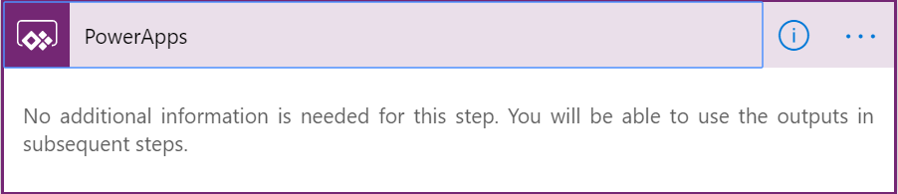
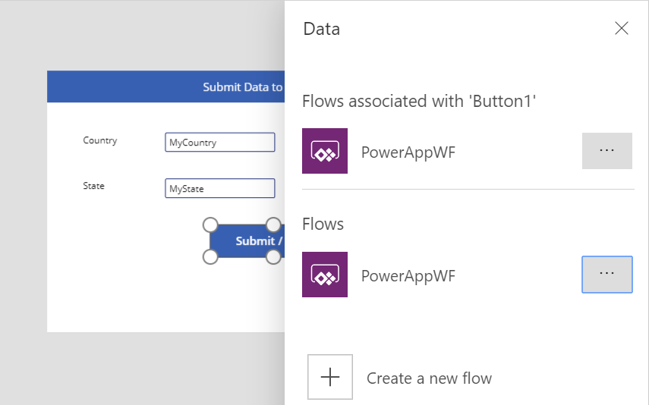
Power Apps Integration flow
You can use Power Automate to create logic that performs one or more tasks when an event occurs in a canvas app. For example, configure a button so that, when a user selects it, an item is created in a SharePoint list, an email or meeting request is sent, a file is added to the cloud, or all of these. You can configure any control in the app to start the flow, which continues to run even if you close Power Apps.

Slide 27
SQL Server Integration flow

Slide 28
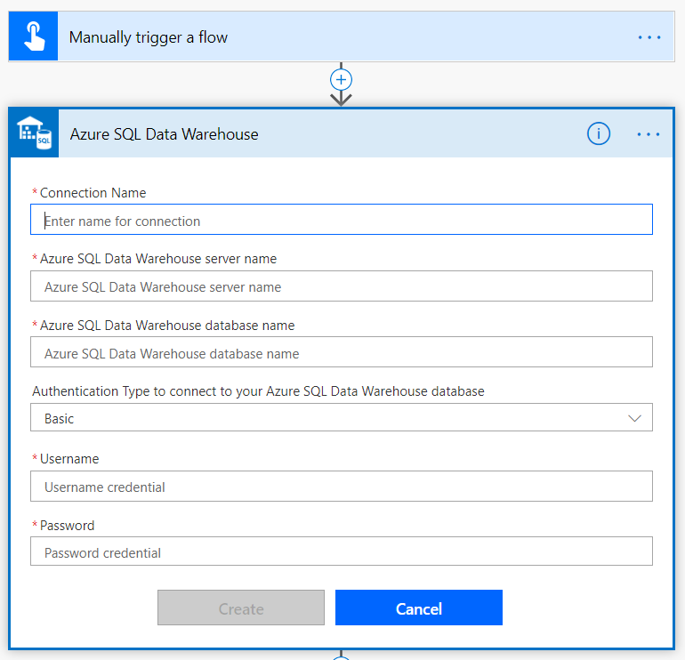
SQL Server Integration flow
Microsoft SQL Server is a relational database management system developed by Microsoft. Connect to SQL Server to manage data. You can perform various actions such as create, update, get, and delete on rows in a table.

Slide 29
Calling Microsoft Flow from your application

Slide 30
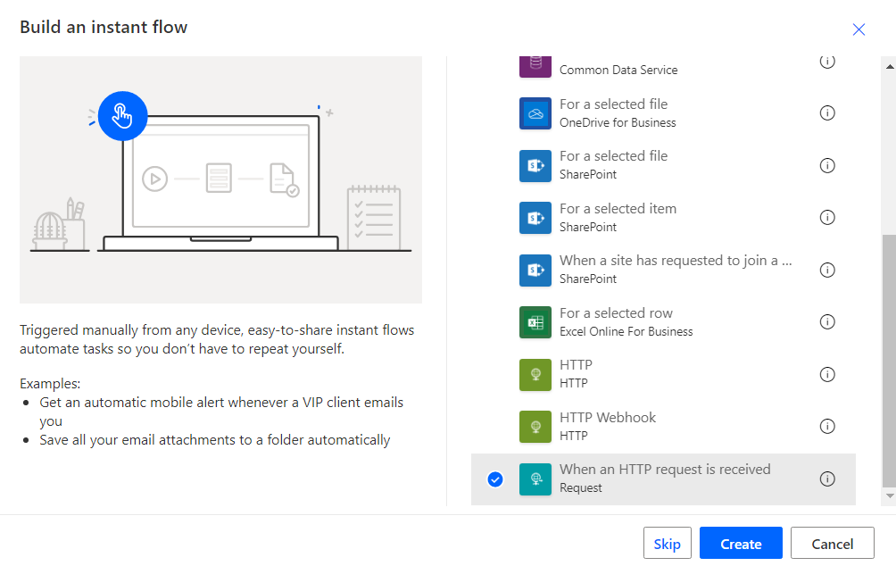
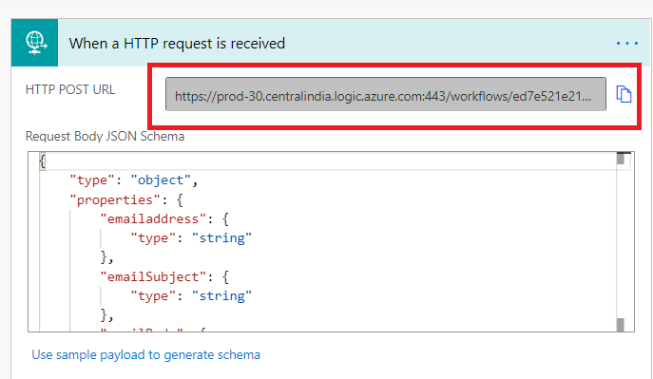
Calling Microsoft Flow from your application
Microsoft Flow allows you to turn complex repetitive tasks into automated multistep flows.
In many cases, you want your flow to be triggered by an event, such as a document update.
In others, you want to let the end user initiate a flow. In this case, Microsoft Flow will serve as an integration glue between your application and large number of other services.
For example, you may want the user to click on a button and send an email to her customers.

Slide 31
Azure Cognitive Services AI Integration flow

Slide 32
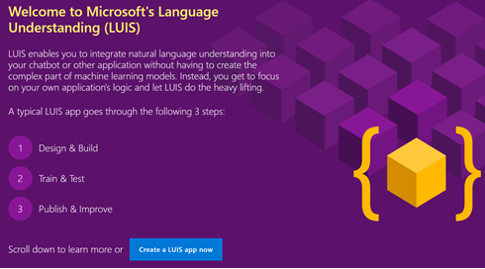
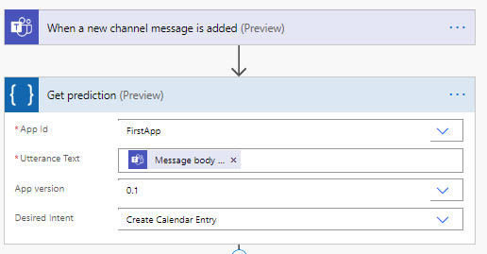
Azure Cognitive Services AI Integration flow
Language Understanding (LUIS) is a cloud-based API service that applies custom machine-learning intelligence to a user's conversational, natural language text to predict overall meaning, and pull out relevant, detailed information.
Azure cognitive services language understanding intelligent service (LUIS) lets you understand language contextually, so your apps communicate with people in the way they speak.
The LUIS integration in Flow enables you to make predictions on a query string.
You can design your Flow to execute a set of actions when the desired intent is detected.

Slide 33
Power Automate vs Azure Logic Apps

Slide 34


Power Automate vs Azure Logic Apps
Have you ever wondered when to use what between Azure Logic Apps and Power Automate/Flow ?
Flow is SaaS. Logic App is PaaS.
Both are cloud-based services for automating workflows across apps and services. Most of the connectors are available in both. Most of the requirements can be achieved using both. Then ,Why Microsoft has built both ?
Certainly, There are some intentions behind every product/service released. Let's understand those things.
Simple vs Complex requirement ?
Developer vs Citizen Developer vs Business User ?
Mobility ?
Money ?
Start with simple thing , Power Automate/Flow, which can be easily configured. We can extend it further using Logic App for complex scenarios
Notes:
https://powerofpowerplatform.com/power-automate-vs-azure-logic-apps/

Slide 35
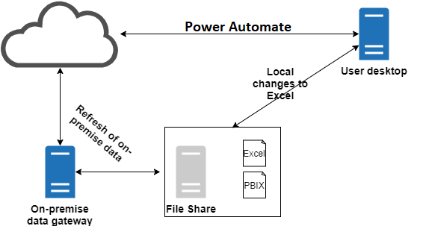
Remote Desktop / Citrix connection using On-Premises Data Gateway
This needs to be on-premises and be able to reach the storage area where the data is kept. If you are using other sources of data, the rule still applies: the data needs to be reachable by this machine.
https://tech.xenit.se/walkthrough-of-setting-up-on-premises-data-gateway-for-power-bi/

Slide 36

Demo

Slide 37
Customer Stories
Questions

Slide 39
Day 4 - Monitoring & Administration of Power Automate

Slide 40












Jenkins NS
Modern Workplace Solution Architect | Consultant
Microsoft Teams, Power Platform and SPFx Specialist
International Speaker | Blogger | Trainer
SPS Bangalore Organizer
aOS Ambassador
jenkinsns@gmail.com
in/jenkinsns
@jenkinsns
http://www.jenkinsblogs.com
jenkinsns
https://www.facebook.com/spfxinfo/
https://www.facebook.com/msteamsinfo

